Slide 1
Lesson 2:
Variables and Scope
By: Ryan Alterman
Revised: 8-25-17

Slide 2
What is a variable?
A named unit of storage
Has multiple types which dictate its memory size
Determines what values it can store
Variable Names
They must start with either a letter or an underscore
C++ is case sensitive
Variable is different than variable

Slide 3
Variable Types
There are many types of variables
Boolean( bool)
True or False value
Character( char)
Utilize ASCII to allow the storage of standard Characters(your keyboard)
Integer( int)
The most basic unit for numerical storage
Float( float)
Basic level of precision numerics(decimals)
Double( double)
More precise version of float
Wide Character( wchar_t)
A wide character type
Void( void)
This designates that the variable returns no type

Slide 4
Variable Declaration and Definition
Declaration
Tells the compiler that a variable with a name exists
But does not actually specify the variable's value
Definition
Usually defined inside the function
This is where the actual variable’s value is specified
Declaration
int number;
Definition
number = 7;

Slide 5
Modifiers
Variables can be given certain modifiers
They change and modify the memory size of variable types
Modifiers
Signed
Unsigned
Long
Short
These change the properties of each variable depending on the modifier
Can only be applied to certain variable types:
Integer: Signed, Unsigned, long, and Short
Character: Signed and Unsigned
Double: long

Slide 6
Modifiers(Cont.)
Signed and Unsigned can be used as prefixes
You can modify long and short
Signed long, unsigned long, signed short, unsigned short
Only usable for int
Shorthand
Can leave out int if:
Using unsigned, short and long
Still put it in though
Type Qualifiers
Can be used to further define a variable
const: values can not be changed
volatile: says that values may change in unexpected ways
restrict: it is used with pointers, says that it is the only way that pointer can be accessed

Slide 7
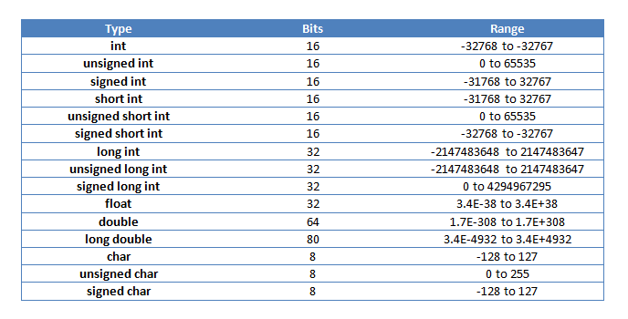

Slide 8
Rvalues and Lvalues
Lvalues
Refer to expressions that are a memory location
Weirdly though, it can be placed in two places:
Left hand assignment
Right hand assignment
Variables are lvalues which means they are declared on the left side
Int x = 10;
Rvalues
Refers to any piece of data that has been stored
These can not have values assigned to them
They have already been defined

Slide 9
What is Variable Scope?
Scope can be defined as:
The region of code in which a variable exists
Scope can be defined in three places:
Inside a function or block of code
Called local variables
Inside the definition of function parameters
Outside of all functions
Global variables

Slide 10
Local Variables
These are declared inside a function or block of code
They can only be seen by objects inside that function or block
Properties:
Only usable inside the current function
Only usable inside the current block
Can not be seen by objects outside of usable areas
I.e. anywhere else

Slide 11
Global Variables
Defined outside of all functions
Usually at the top of the program
Properties:
Can be seen by all objects throughout the program
Will hold their value for entirety of program
Can be called whenever after its declaration

Slide 12
Challenge
I want you to just mess around with variables. Try as many types as you want. Make local and globals, try some modifiers and see what you get. KEEP IT APPROPRIATE!

Slide 13
Next: Constants/Literals

